Slide 1
Employee Photo Album
So Cal Dental Partners

Slide 2
Navigation to Individual Offices
Sea Country Dental
Rancho Niguel Dental Group
South Coast Dental Specialties
SC Dental Care
So Cal Dental Corporate
Inland Dental Center Highland
Inland Dental Center
Mission Dental Implant Center
Inland Dental Center Heritage Court
Alicia Orthodontic & Pediatric
Inland Dental Specialties

Slide 3
Sea Country Dental

Slide 4
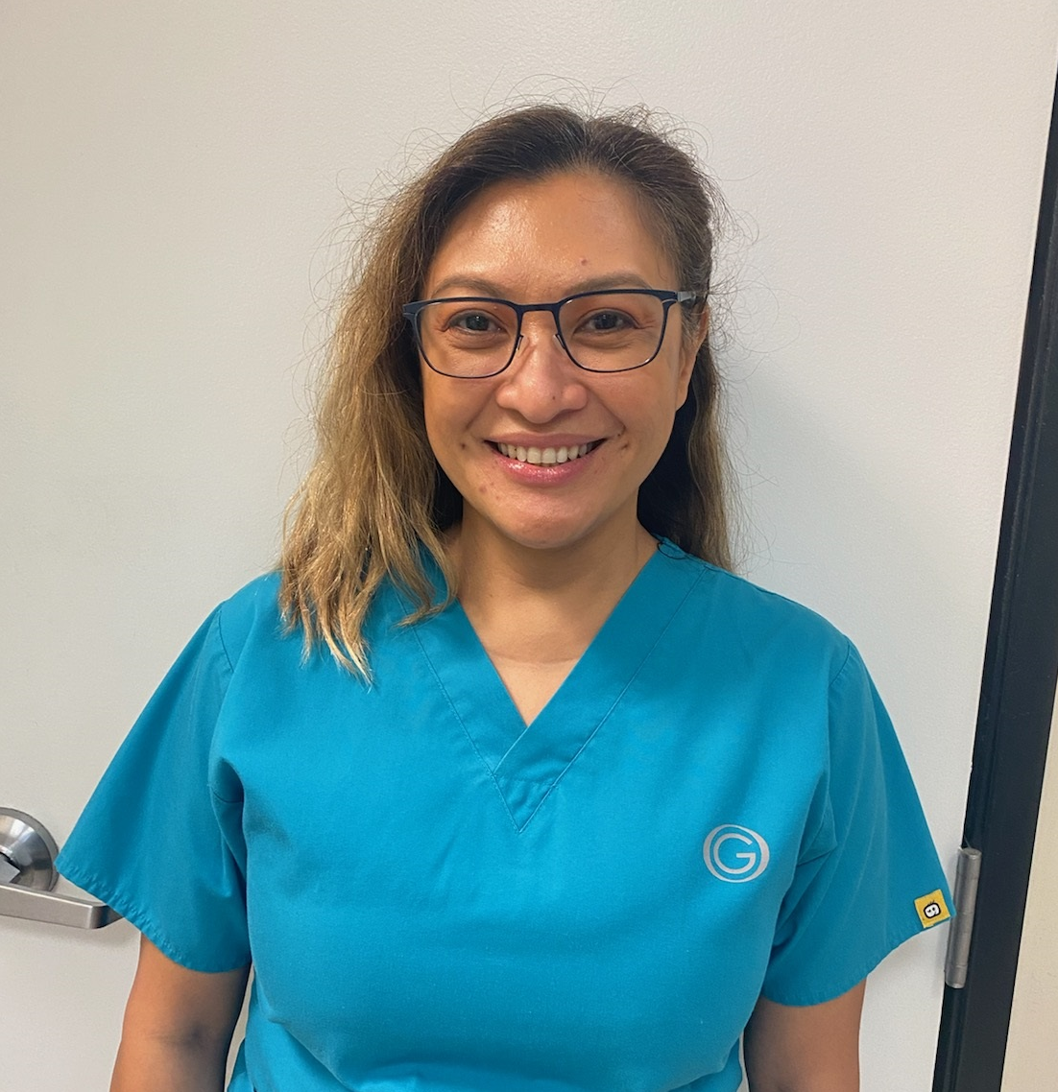
Dr. Del Campo

Slide 5
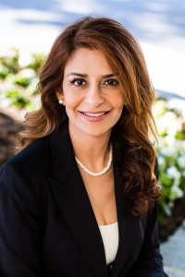
Dr. Shirin Moshrefi

Slide 6
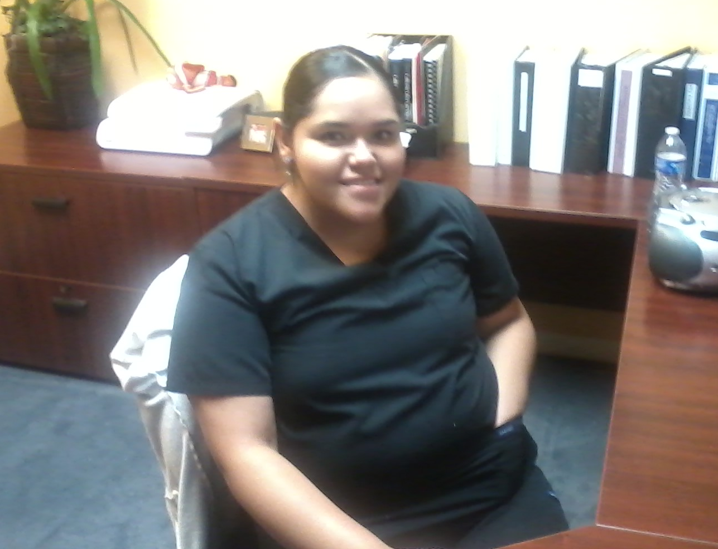
Auriestela Gomez

Slide 7
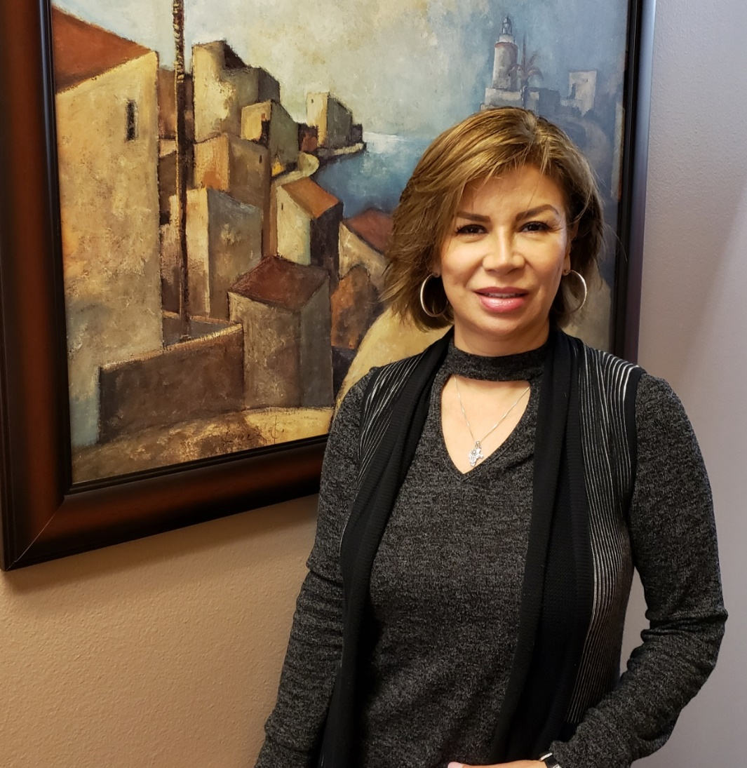
Cande Labander

Slide 8
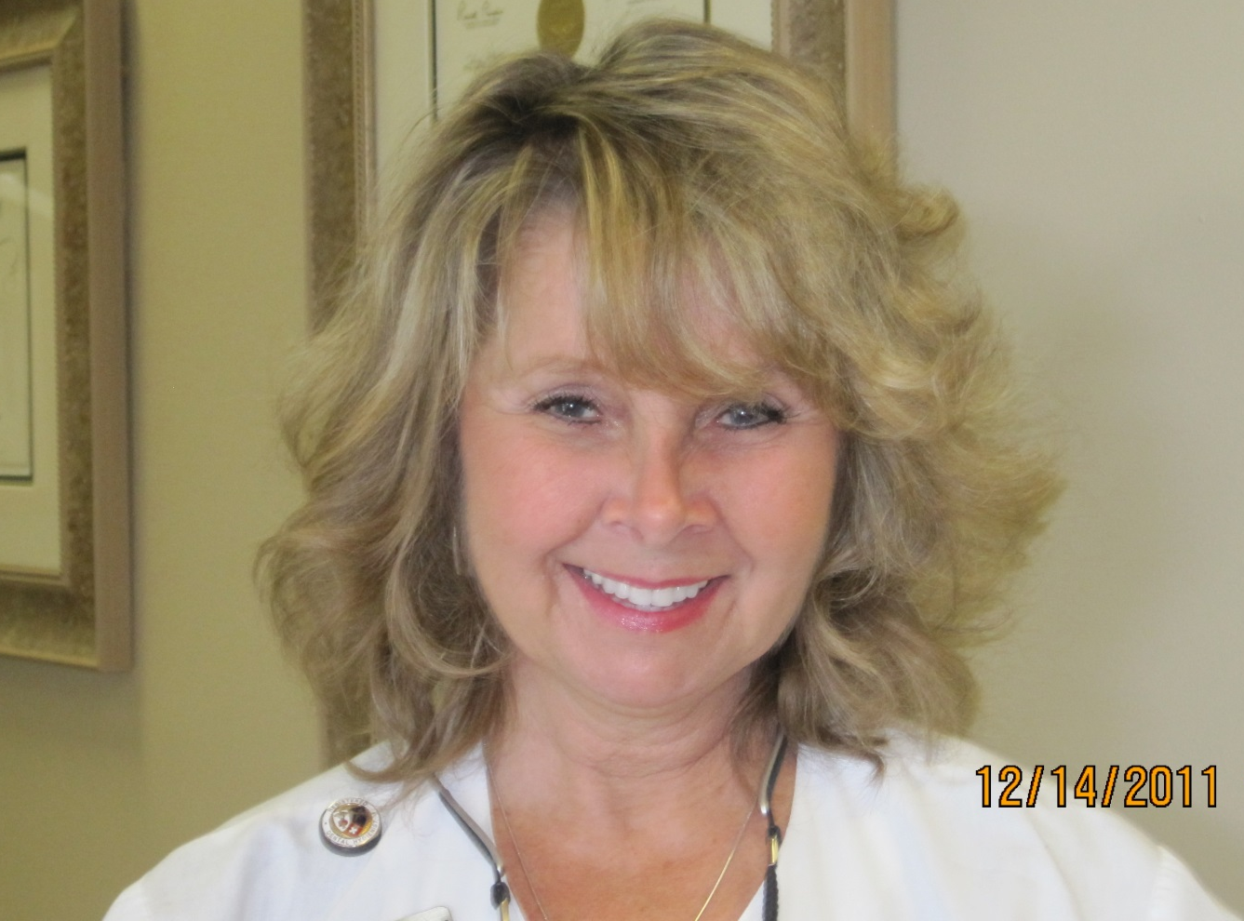
Cheryl Lonzello

Slide 9
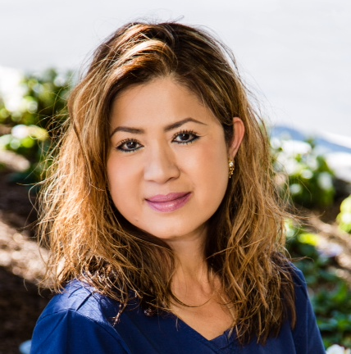
Connie Phan

Slide 10
Gracie Alvarez

Slide 11
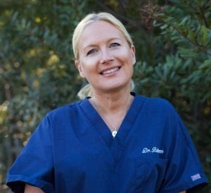
Wiebke Bultmann

Slide 12
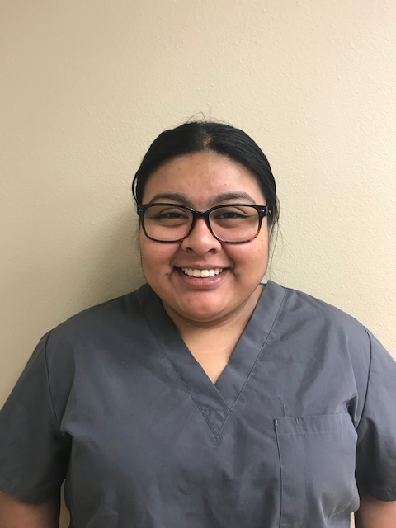
Joanna De Los Angeles

Slide 13
Kassandra Cortez

Slide 14
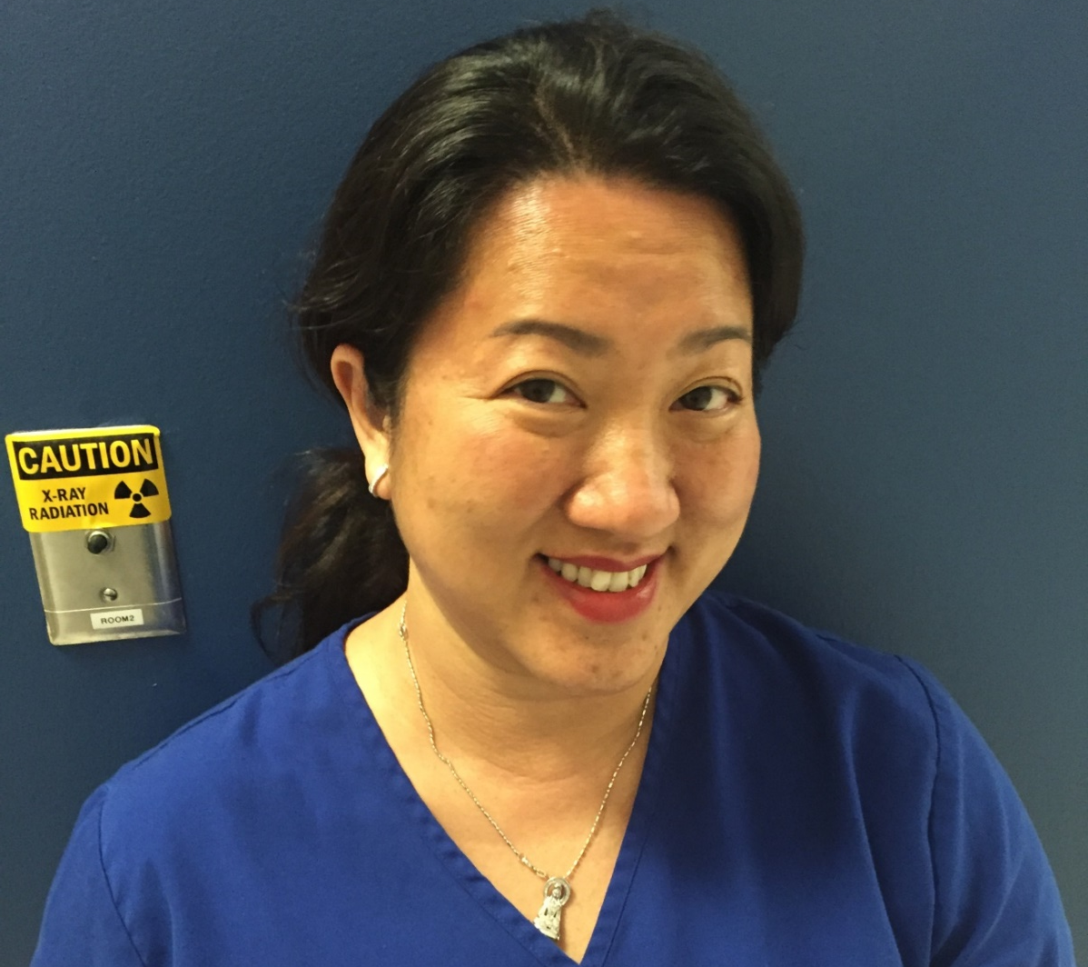
Kim Vu

Slide 15
LaVerle Quigley

Slide 16
Maria Hernandez

Slide 17
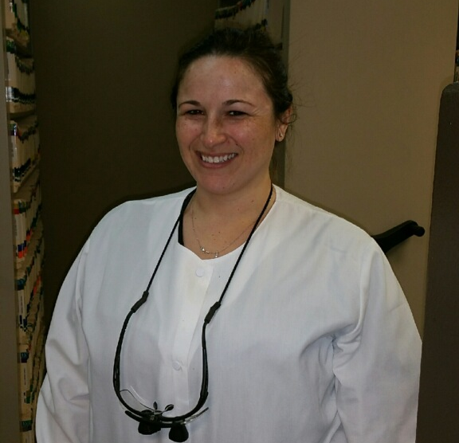
Nicole Camp

Slide 18
Rancho Niguel Dental Group

Slide 19
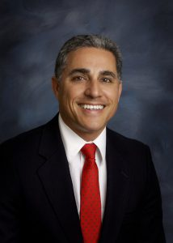
Dr. Arthur Onitiveros

Slide 20
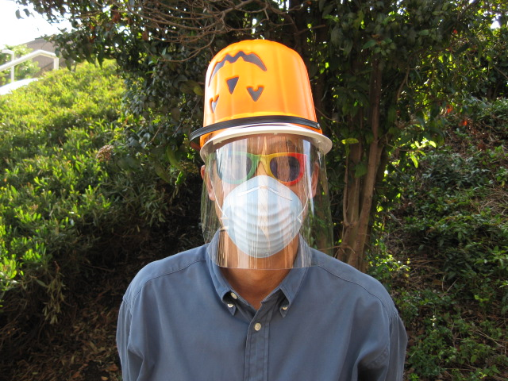
Dr. Gary Mar

Slide 21
Dr. Michael Lien

Slide 22
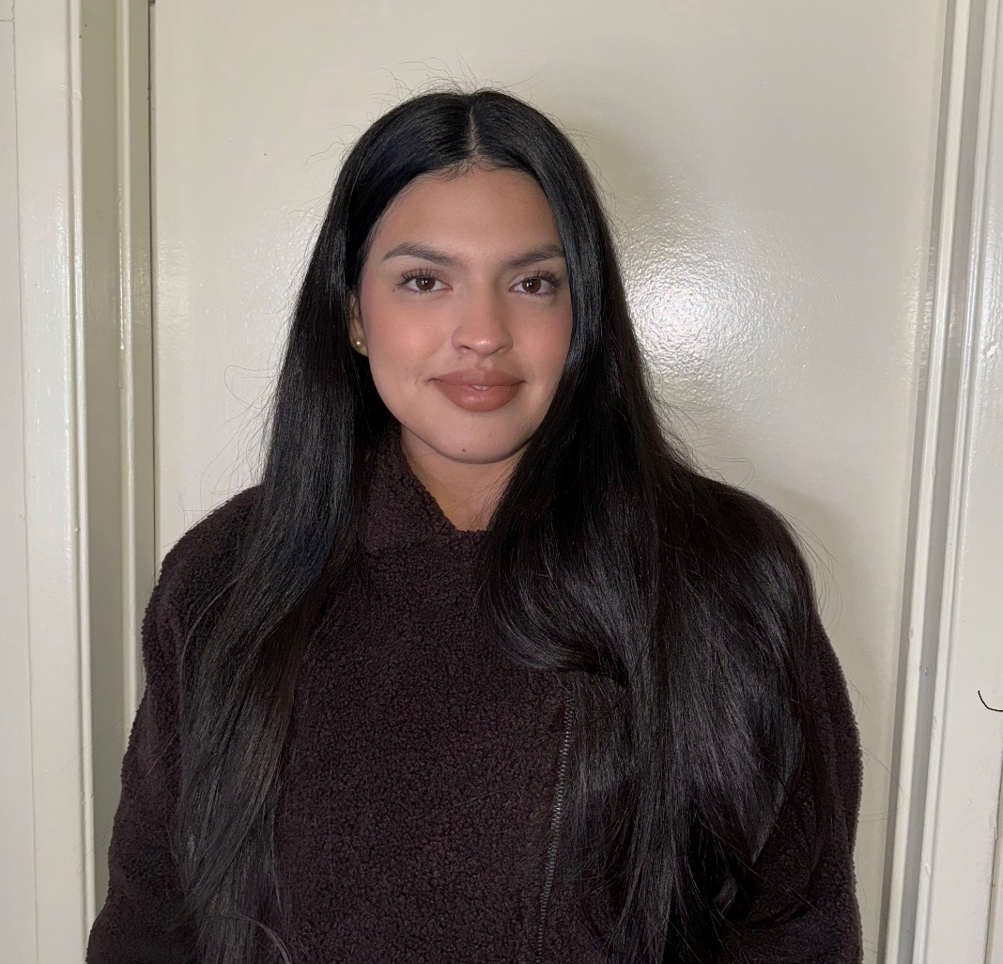
Ana Estrada

Slide 23
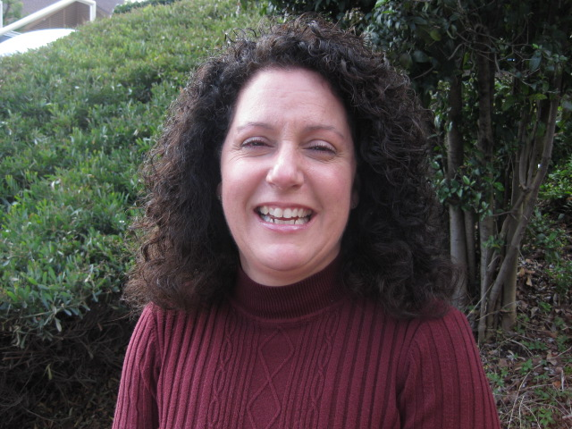
Angelina Robitaille

Slide 24
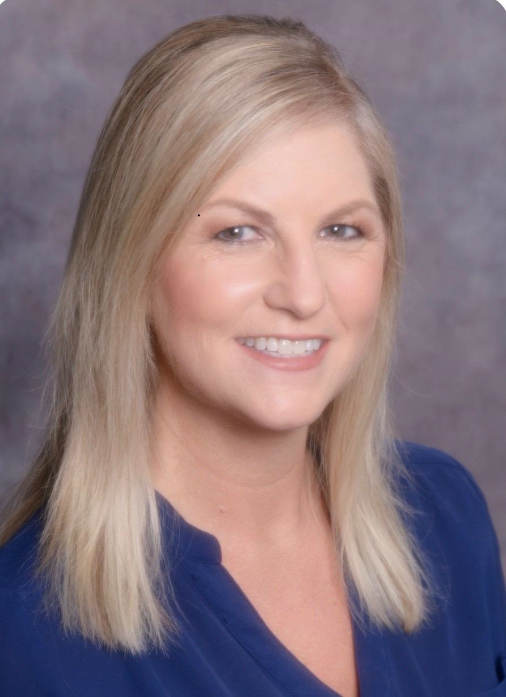
Angie Falletta

Slide 25
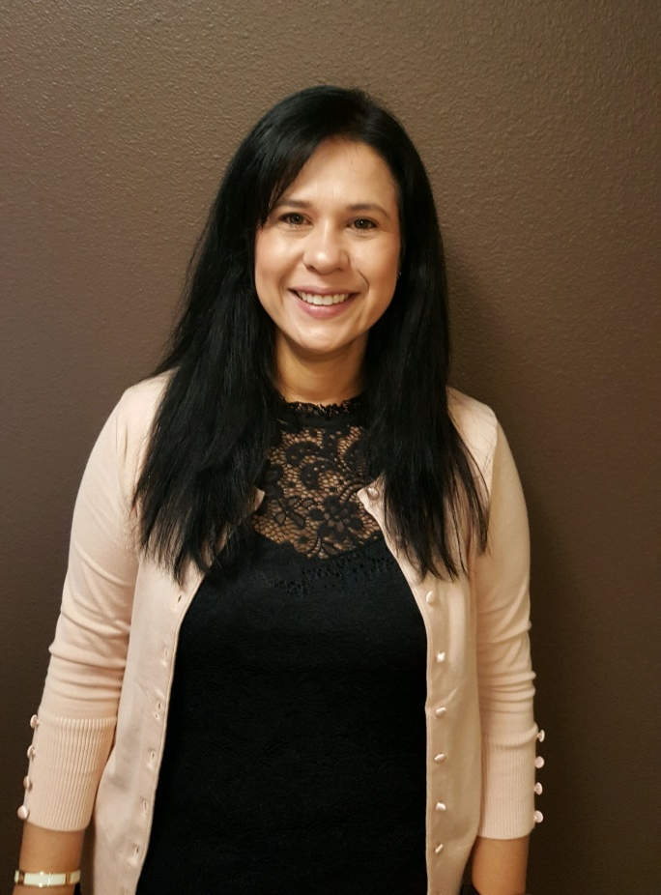
Candy Lopez

Slide 26
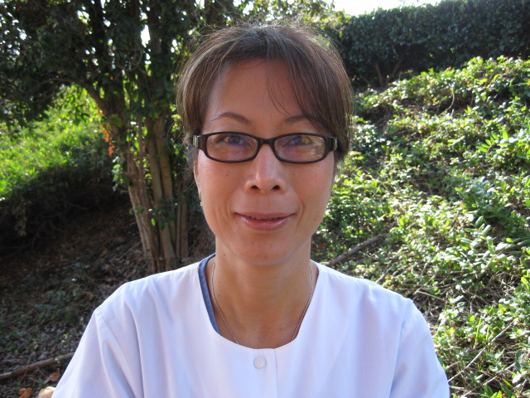
Catherine Dang

Slide 27
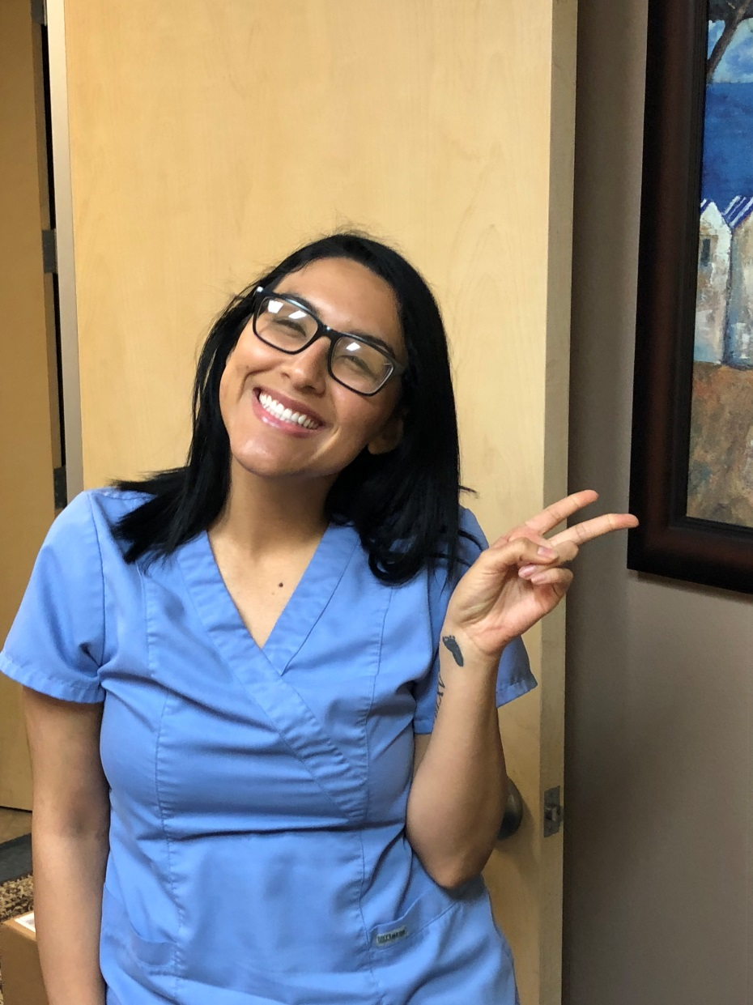
Danielle Estrada

Slide 28
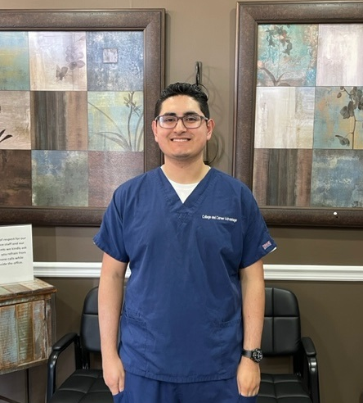
Devin Larios

Slide 29
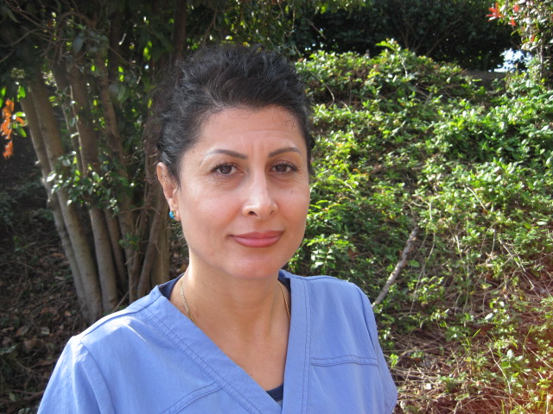
Farah Aghajan

Slide 30
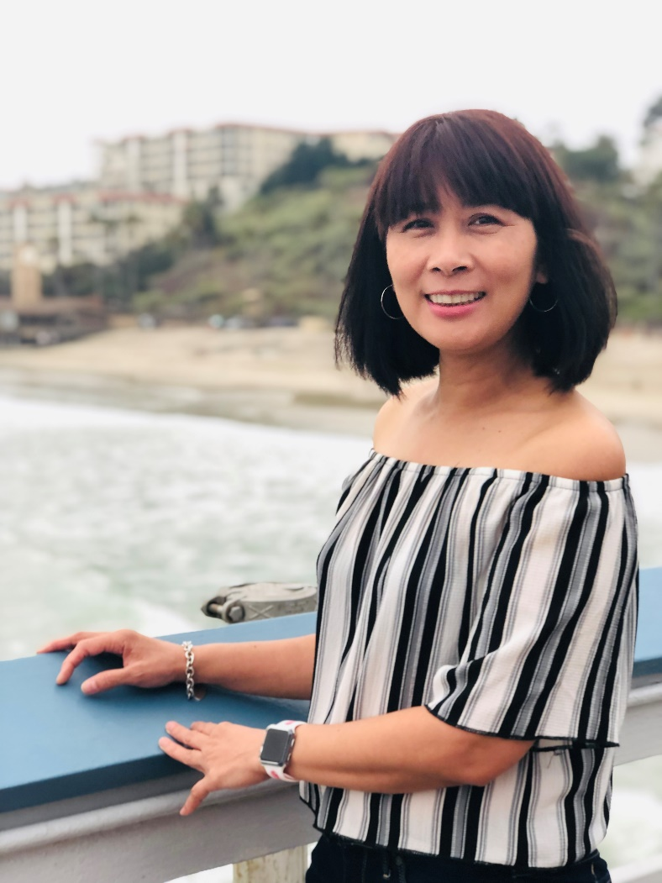
Helen Perez

Slide 31
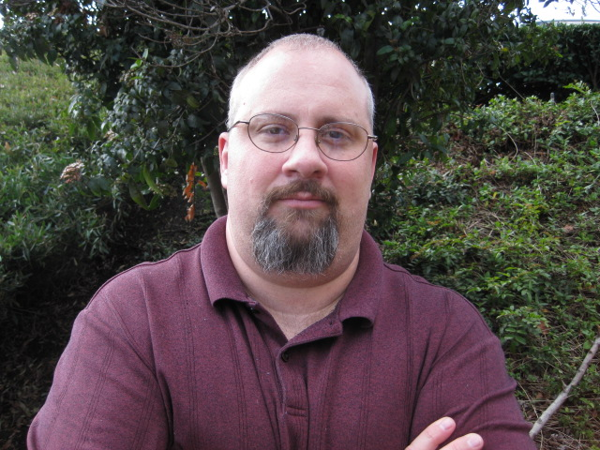
JP Lemann

Slide 32
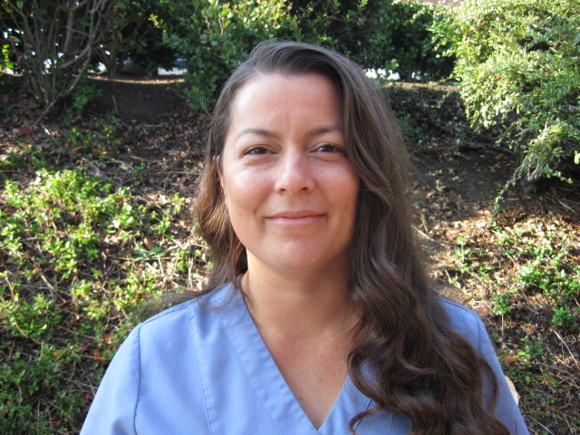
Kelly Alvarez

Slide 33
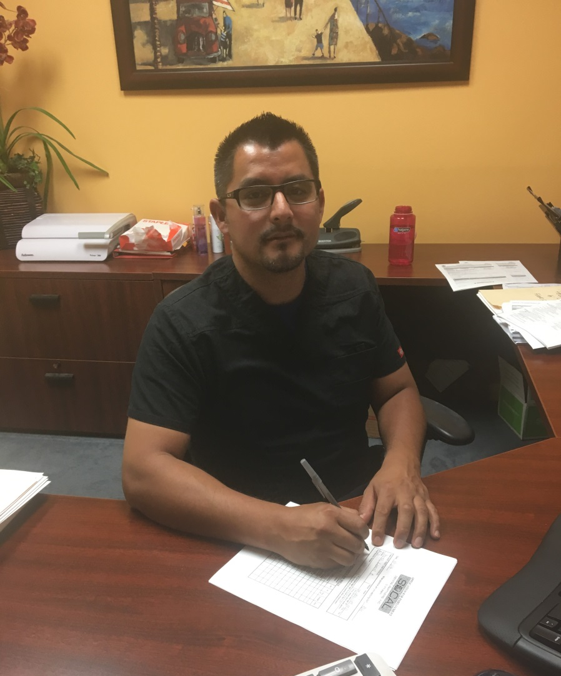
Leonel Perez

Slide 34
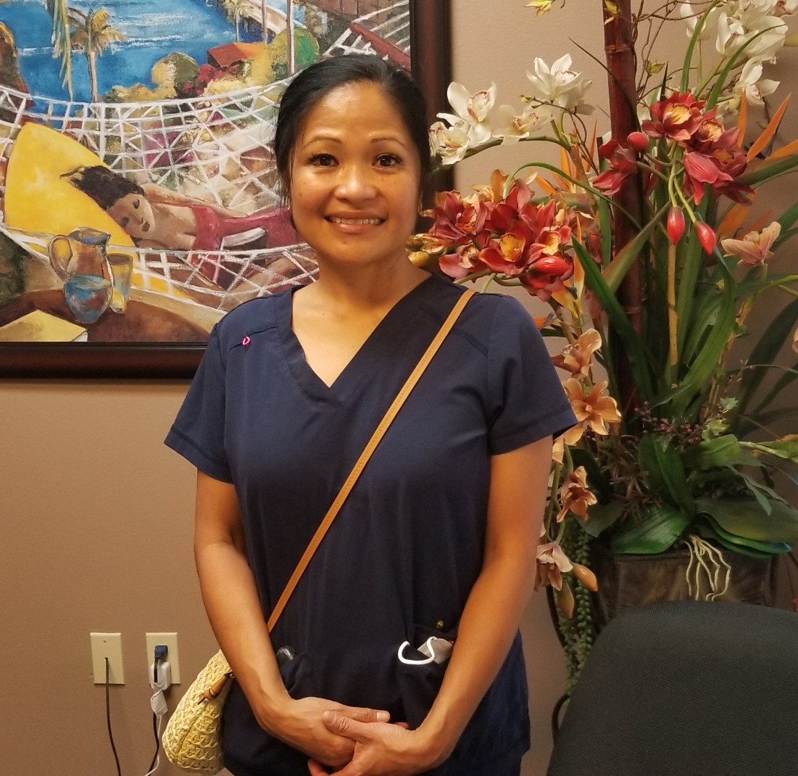
Maria Yaneza

Slide 35
Melina Vidaurre

Slide 36
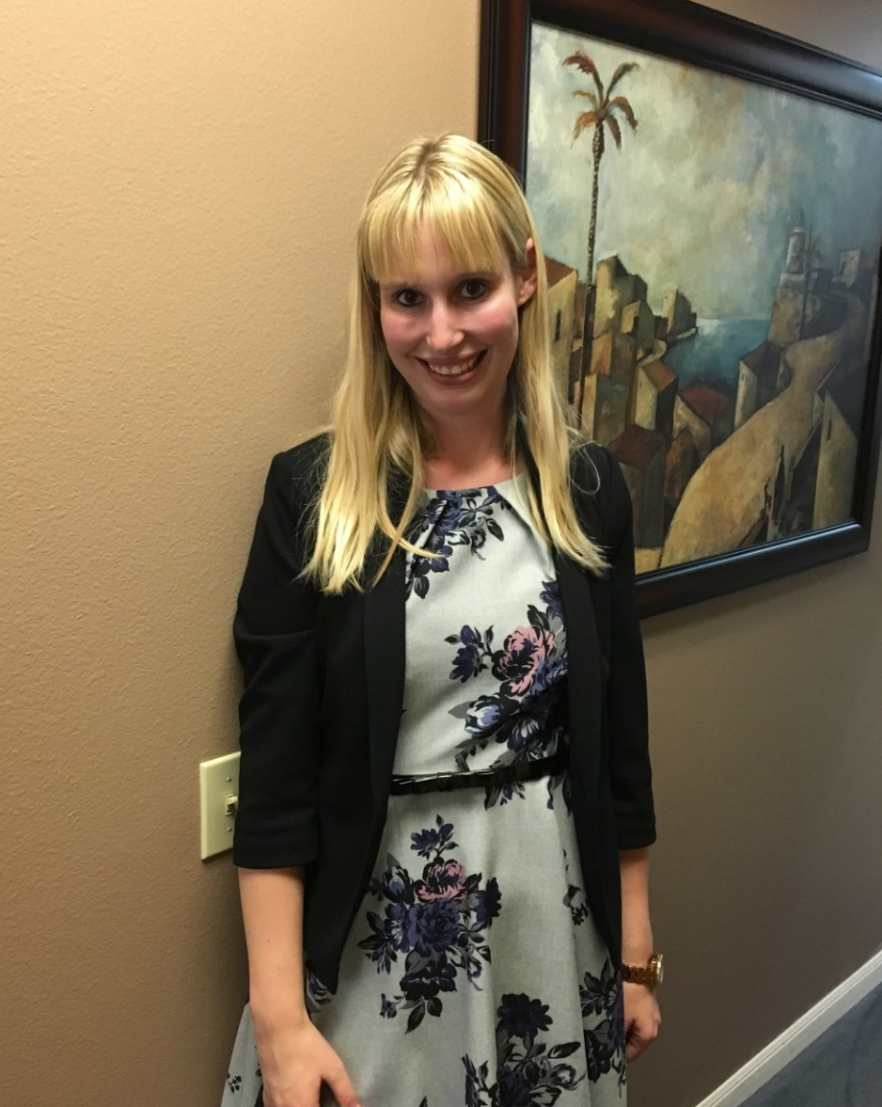
Noelle Braun

Slide 37
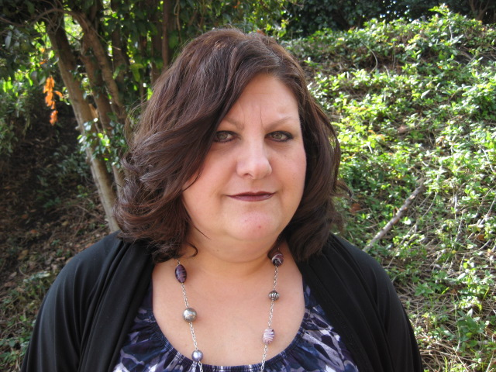
Tina Becerra

Slide 38
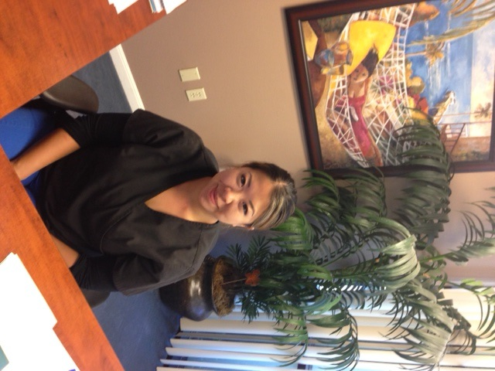
Wendy Wu Sotelo

Slide 39
South Coast Dental Specialties

Slide 40
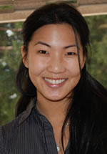
Dr. Angela Hsiao

Slide 41
Dr. Khanh Nguyen

Slide 42
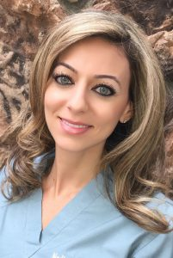
Dr. Nadia Hassan

Slide 43
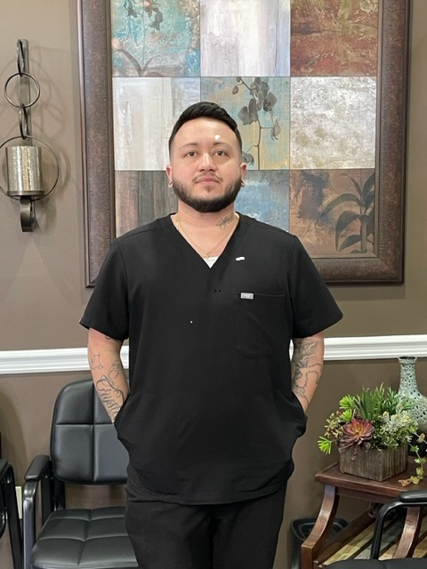
Adrian Jaramillo

Slide 44
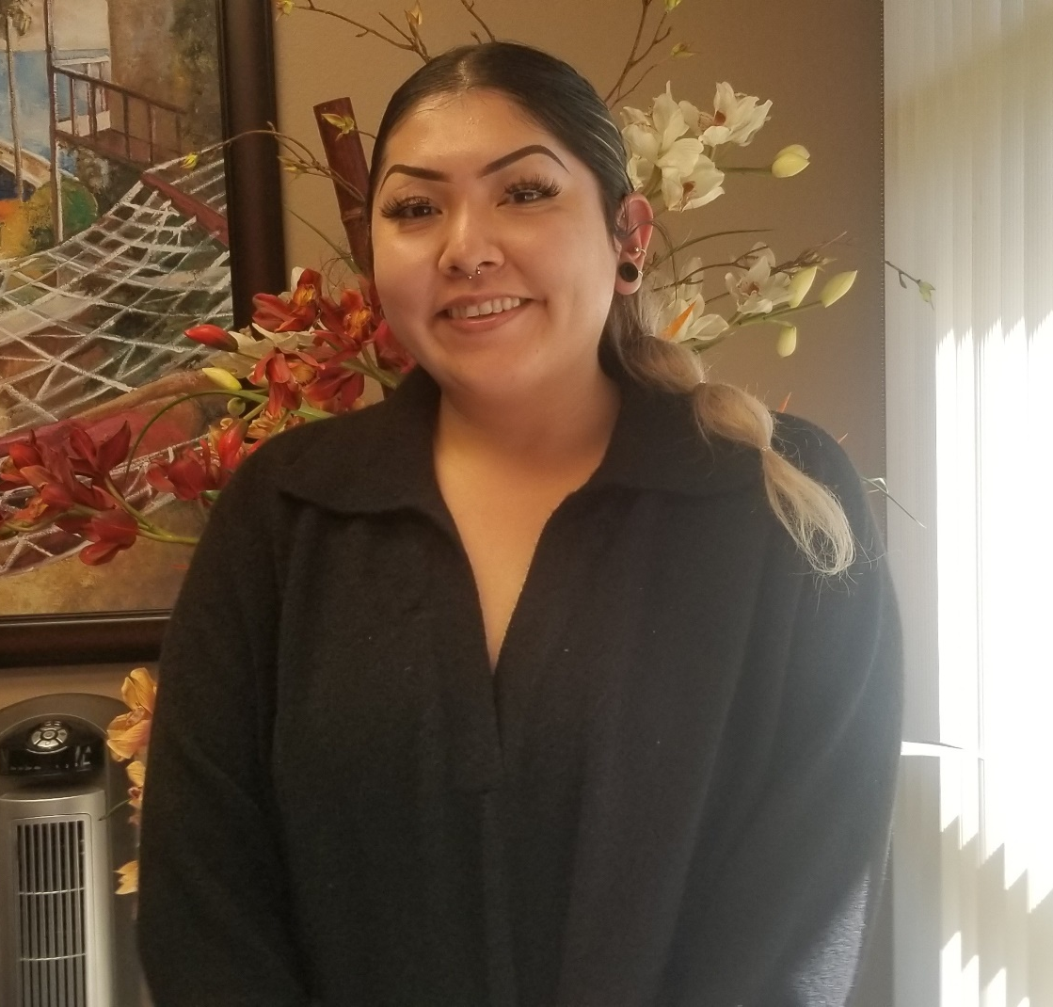
Carina Sanchez

Slide 45
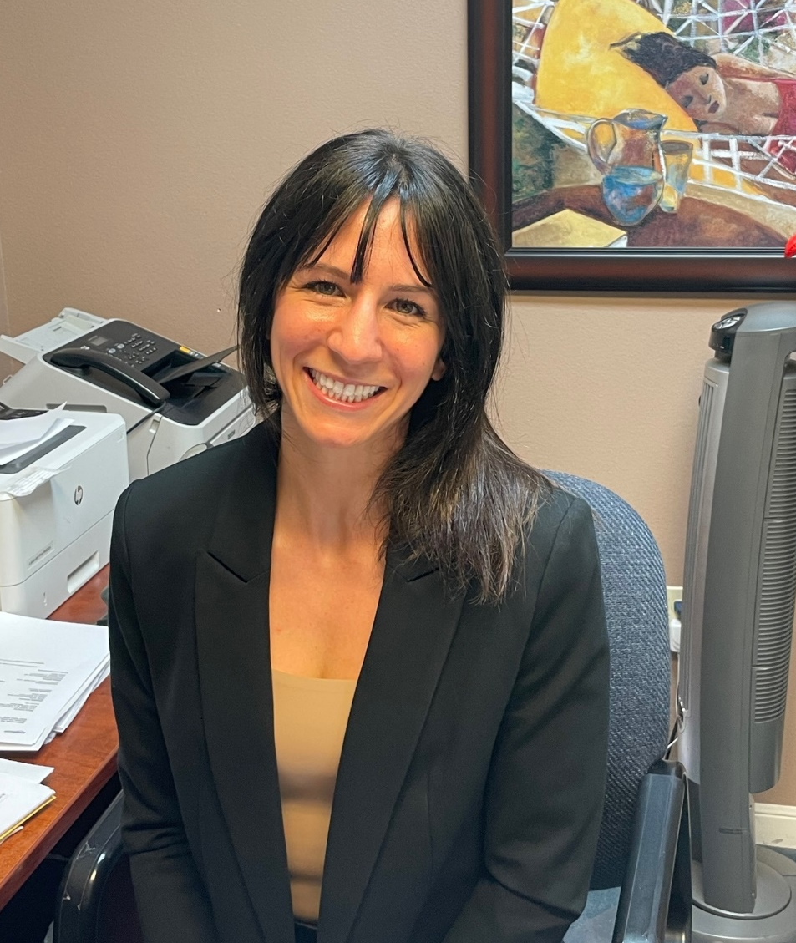
Christina Diaz

Slide 46
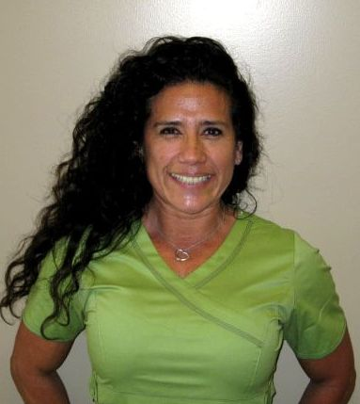
Lourdes Barrueto

Slide 47
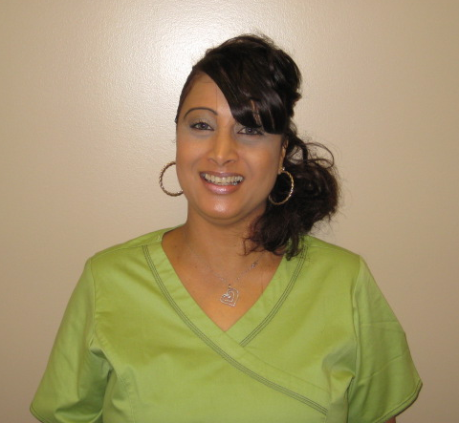
Phyllis Soltis

Slide 48
Sarah Carroll

Slide 49
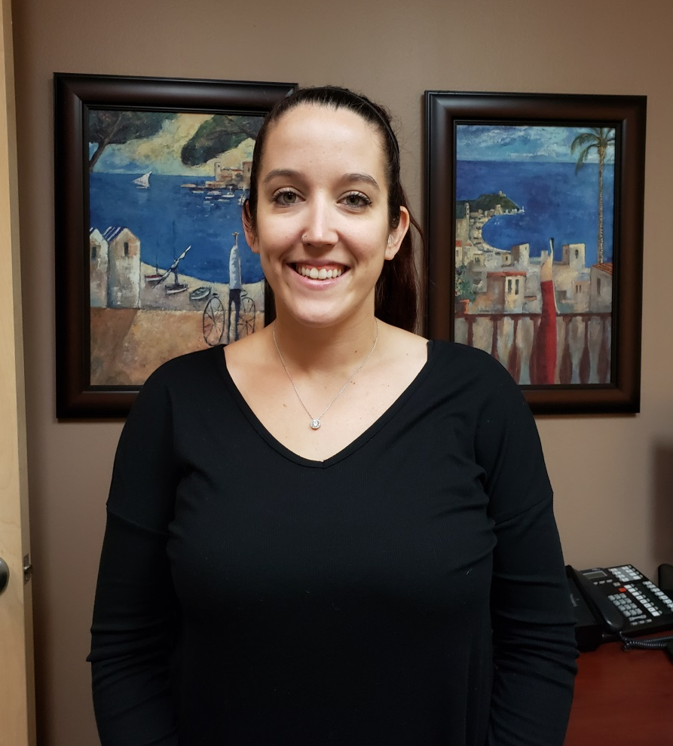
Sarah Duff

Slide 50
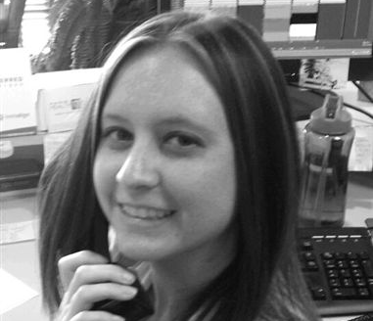
Stephanie Dartt

Slide 51
Steven Iniguez

Slide 52
SC Dental Care

Slide 53
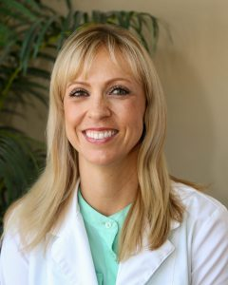
Dr. Alison Austin

Slide 54
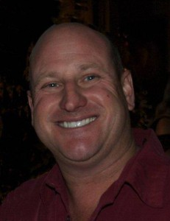
Dr. Paul Murray

Slide 55
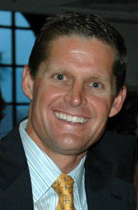
Dr. Rodney Boyd

Slide 56
Dr. Tom Shinmoto

Slide 57
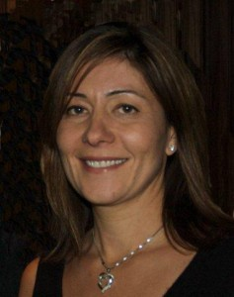
Dr. Tabby Abulhosseini

Slide 58
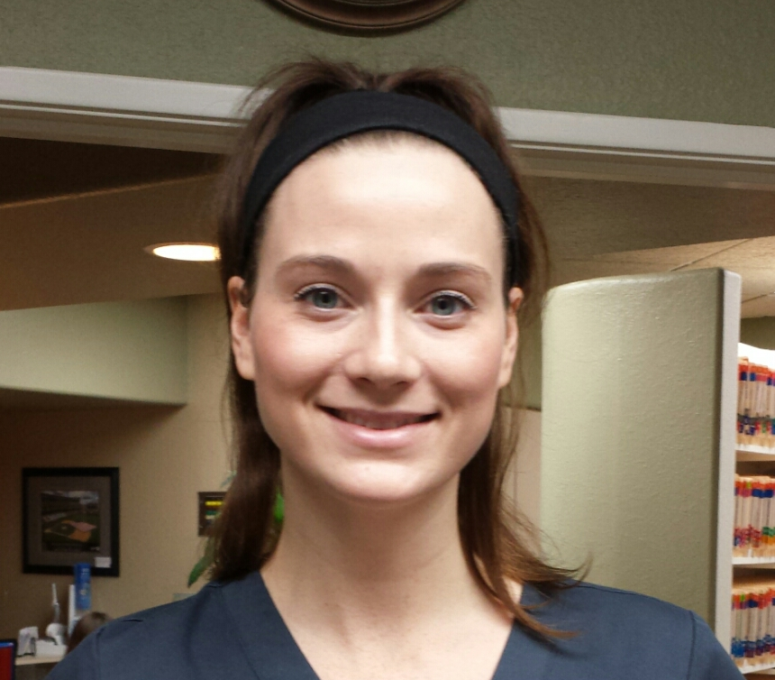
Briann Koutzoukis

Slide 59
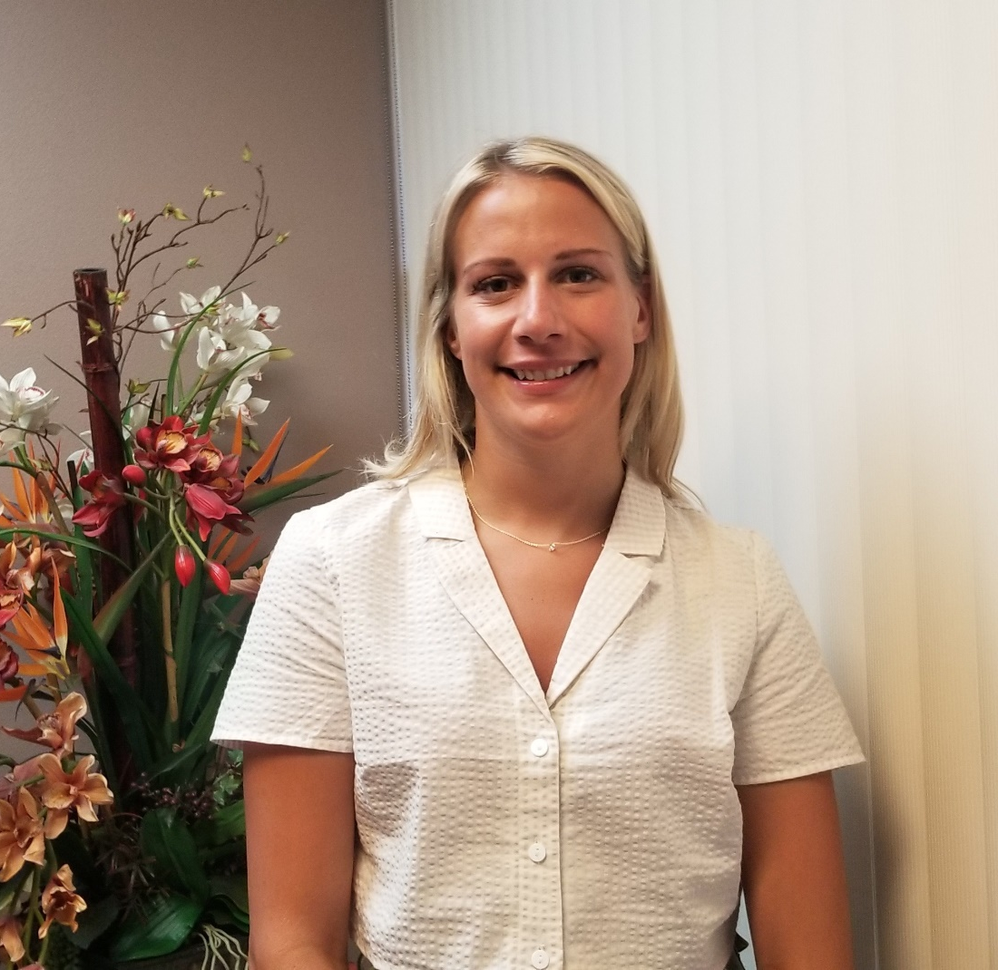
Camie Jepson

Slide 60
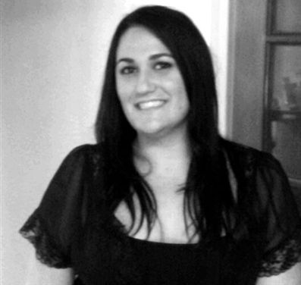
Carissa Scarborough

Slide 61
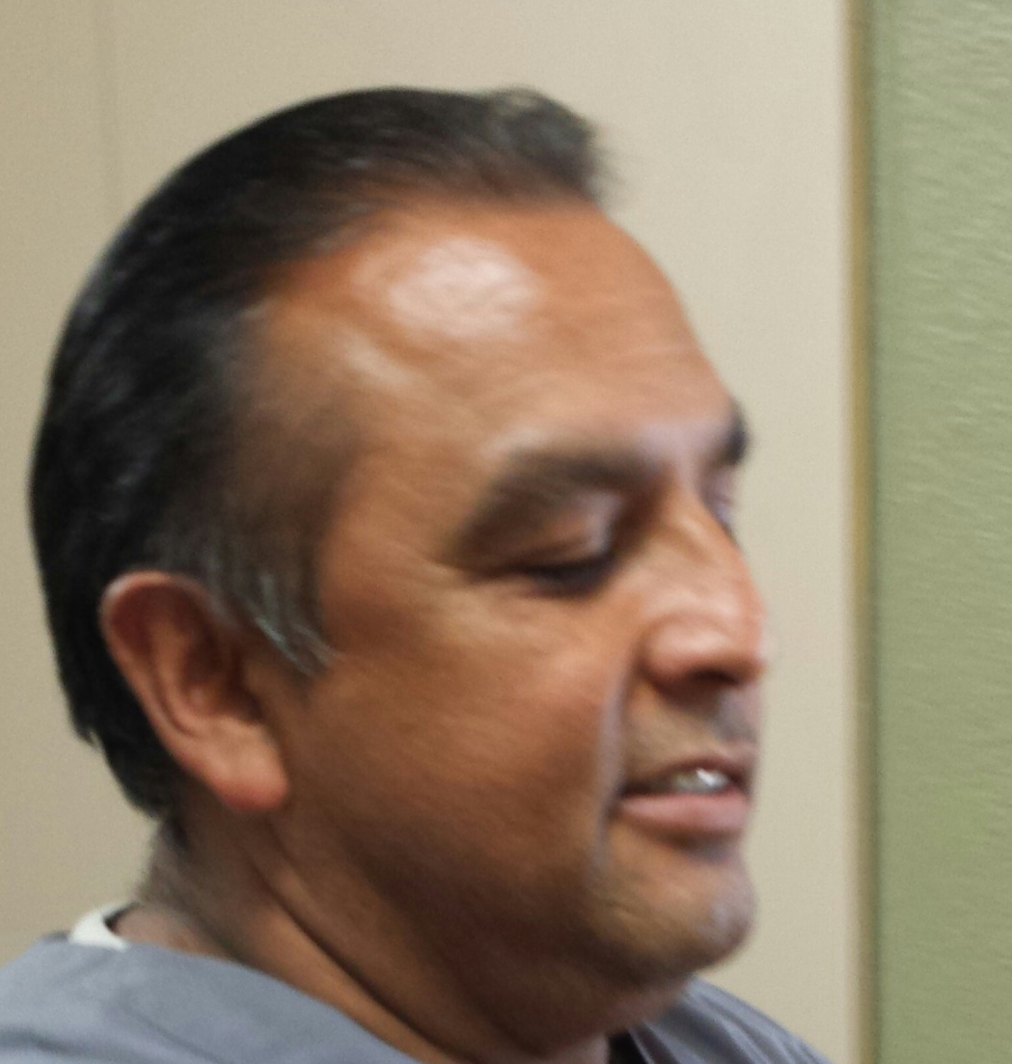
Danny Oliveros

Slide 62
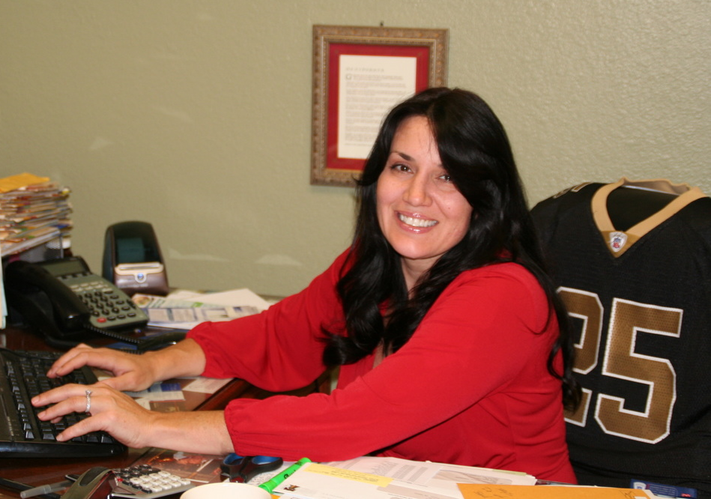
Dee Devane

Slide 63
Jenny Rios

Slide 64
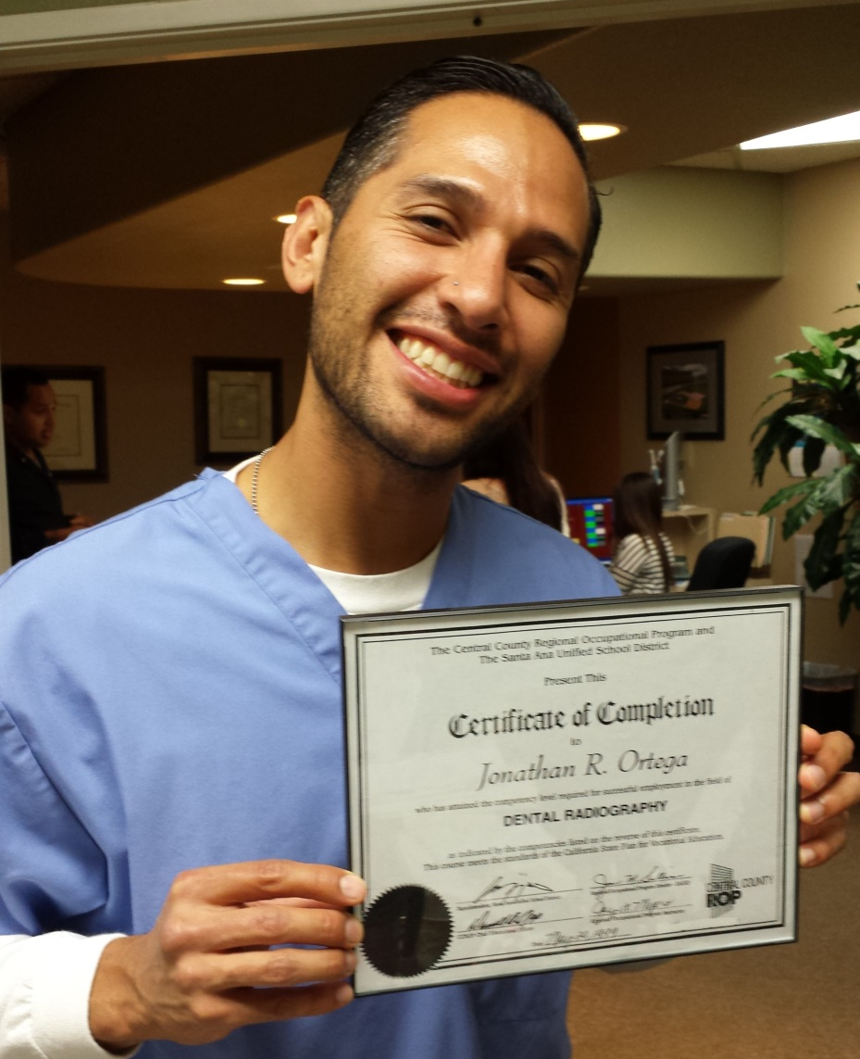
Jonatan Ortega

Slide 65
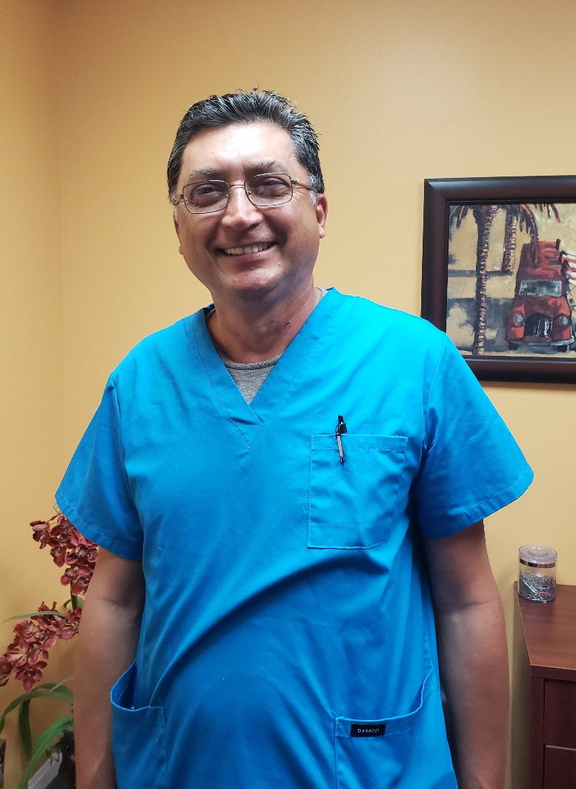
Jose Ortegon

Slide 66
Liliana Jones

Slide 67
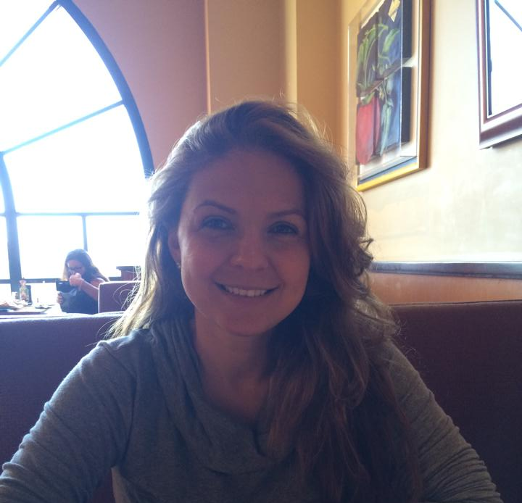
Nurcin (Farrah) Hansen

Slide 68
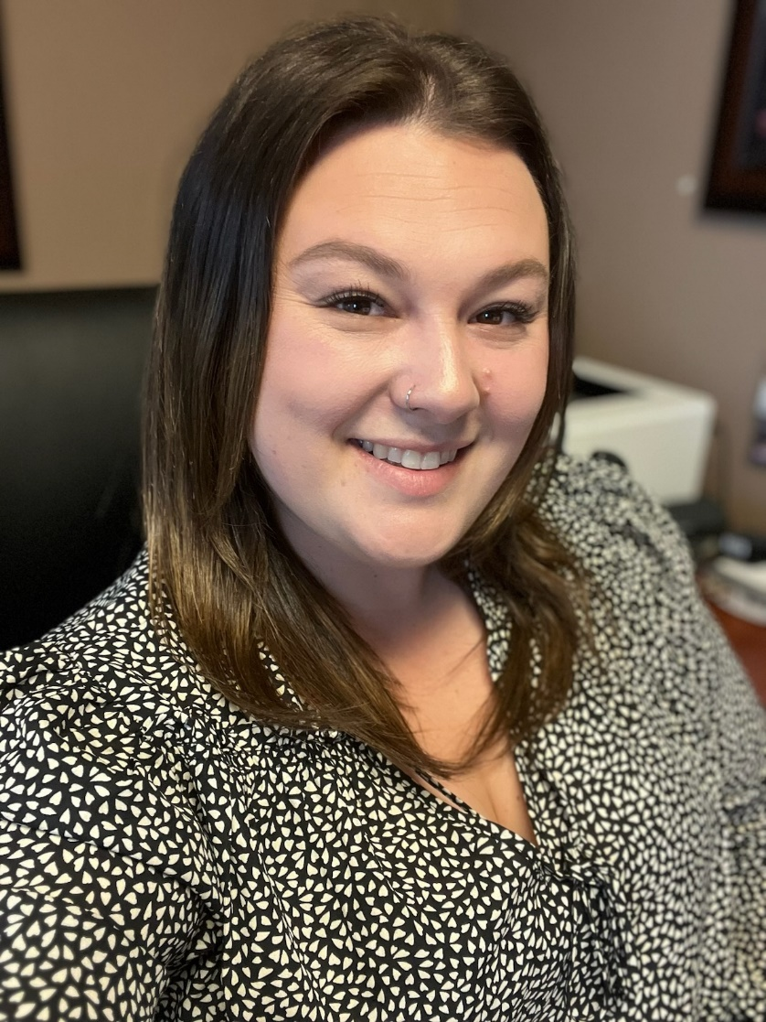
Taylor Odasso

Slide 69
Thuy Nguyen

Slide 70
Vivian Jimenez

Slide 71
So Cal Dental Corporate

Slide 72
Debbie Jezowski

Slide 73
Karly Warner

Slide 74
Monica DuBois

Slide 75
Renee Dobbert

Slide 76
Rosie Larrea

Slide 77
Sandra Molina

Slide 78
Maria Trimble

Slide 79
Inland Dental Center Highland

Slide 80
Dr. Andrew Najem

Slide 81
Dr. Anthony Boyd

Slide 82
Dr. Carmelo Bruny

Slide 83
Dr. Cecilia Kao

Slide 84
Dr. Devin Anderson

Slide 85
Dr. Karin Johnsen

Slide 86
Dr. Keli Wright

Slide 87
Dr. Mark Johnsen

Slide 88
Dr. Ronald Simus

Slide 89
Breanna Young

Slide 90
Briana Willhide

Slide 91
Cori Kempton

Slide 92
Diana Barajas

Slide 93
Elma Tilei

Slide 94
Eva Hernandez

Slide 95
Gina Johnson

Slide 96
Janelly Vargas

Slide 97
Jazmin Barrera

Slide 98
Jennifer Gallo

Slide 99
Luz Montoya

Slide 100
Michael Evanovich

Slide 101
Monique Rico

Slide 102
Morgan Jaso

Slide 103
Rachelle Roark

Slide 104
Regina Calderon

Slide 105
Rosa Mendez

Slide 106
Sara Sobredo

Slide 107
Savannah Irelan

Slide 108
Sharon Bailon

Slide 109
Tanijha Kilpatrick

Slide 111
Xanat Cruz-Ramirez

Slide 112
Inland Dental Center

Slide 113
Dr. Anthony Boyd

Slide 114
Dr. Calvin Mclemore III

Slide 115
Dr. Carmelo Bruny

Slide 116
Dr. Grace Sanchez

Slide 117
Dr. Juliana Carvalho

Slide 118
Dr. Luiza Portnoff

Slide 119
Dr. Ronald Simus

Slide 120
Ana Parea-Adams

Slide 121
Ashley Boyd

Slide 122
Brianna Buccille

Slide 123
Carlos Felix

Slide 124
Carolina Lucas

Slide 125
Carolina Rodriguez

Slide 126
Caroline Boyd

Slide 127
Cathy Hernandez

Slide 128
Mayra Lopez

Slide 129
Helen Mejia

Slide 130
Ericka Meza

Slide 131
Charito Pugh

Slide 132
Eva Hernandez

Slide 133
Frances Madore

Slide 134
Frankie Hernandez

Slide 135
Helen Mejia

Slide 136
Yuritza Rodriguez

Slide 137
Janet Alvarado

Slide 138
Janet Meza

Slide 139
Jenika Joseph

Slide 140
Jennifer Bierschbach

Slide 141
Kimberly Van Dyke

Slide 142
Linda Soto

Slide 143
Lisa Estrada

Slide 144
Luann Perez

Slide 145
Lucia Vasquez

Slide 146
Marlena Saldana

Slide 147
Mayra Saldana

Slide 148
Monica Avilez

Slide 149
Monica Leyva

Slide 150
Nereyda Santoyo

Slide 151
Robyn Atkins

Slide 152
Rosalind Graves

Slide 153
Sheila Mayo

Slide 154
Vangie Lee

Slide 155
Veronica Santos

Slide 156
Yolanda Lopez

Slide 157
Inland Dental Center Heritage Court

Slide 158
Dr. Anthony Boyd

Slide 159
Dr. Dennis Hopkins

Slide 160
Dr. Ronald Simus

Slide 161
Dr. Wesley Okumura

Slide 162
Alejandra Figueroa

Slide 163
Alejandra Magana

Slide 164
Alyssa Ortega

Slide 165
Alyssa Rios

Slide 166
Angel Rodriguez

Slide 167
Aaron Fuentes

Slide 168
Barbara Dooley

Slide 169
Barbie Smiley

Slide 170
Cecilia Gravdahl

Slide 171
Cyndi Sullivan

Slide 172
Diana Aldana

Slide 173
Dolores Cruz

Slide 174
Donna Williams

Slide 175
Jadassa Guieb

Slide 176
Lucrecia Rodriguez

Slide 177
Meri Jo Hunter

Slide 178
Melissa Ortega

Slide 179
Michelli Perez

Slide 180
Odet Michel Rodriguez

Slide 181
Otto Duran-Herrera

Slide 182
Rena Comer

Slide 183
Savannah Riojas

Slide 184
Yessenia Ramirez Herrera

Slide 185
Alicia Orthodontic & Pediatric

Slide 186
Dr. Alison Austin

Slide 187
Kim McCabe

Slide 188
Lizet Sanchez

Slide 189
Lorraine Balogh

Slide 190
Mayra Ledesma

Slide 191
Noi Chanthavong

Slide 192
Inland Dental Specialties

Slide 193
Dr. Eri Sahl

Slide 194
Dr. Luiza Portnoff

Slide 195
Dr. Tory Silvestrin

Slide 196
Jaciel Silvernale

Slide 197
Jasmine Silva

Slide 198
Juliana Rodriguez

Slide 199
Marlene Martinez

Slide 200
Natalie Andrade

